Slide 1
Analysis HXN, March 2018
CdTe system

Slide 2
Rocking curve
Scanid: [45193:1:45233]
Excel lab book, line 135
Angles:
th_start = 81.25;
th_end = 83.75;
XRF channel = 7 (Cu fluorescence channel); used for the alignment of the fluorescence map

Slide 3
Assimetry in rocking curve and shift in the map’s columns comes from drift of grain during rock scan

Slide 4
Shift applied in each map of the rocking curve
shift starts to be problematic

Slide 5
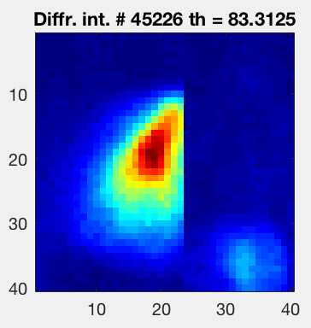
Identification of the ROI in the real space where the rocking curve is complete
Rocking curve in pixel (19,20)
pixel(19,20)
pixel(19,30)
row 19
Rocking curve in pixel (19,30)

Slide 6
Rocking curve 1
Scanid: [45193:1:45233]
Excel lab book, line 135
Angles:
th_start = 81.25;
th_end = 83.75;
XRF channel = Det1_Cu (Cu fluorescence channel); used for the alignment of the fluorescence map
PC channel = sclr1_ch3

Slide 7
2D maps corresponds to the angles in the rocking curve under the shaded area

Slide 8
Rocking curve 7
Scanid [45477:1:45487 45449:1:45459 45460:1:45470]
Excel lab book, line 385 - 390
Angles:
th_start = 83.6;
th_end = 85.08;
XRF channel = Det1_Cu (Cu fluorescence channel); used for the alignment of the fluorescence map
PC channel = sclr1_ch3

Slide 10
Transition:
Line 407:
move to a new area, decide to take an initial xbic measurement and then just stop xbic measurements from there on. Since they degrade too quickly in the beam

Slide 11
Rocking curve 9
Scanid: [45526:1:45546]
Excel lab book, line 461
Angles:
th_start = 83.43;
th_end = 84.43;
XRF channel = Det1_Cu (Cu fluorescence channel); used for the alignment of the fluorescence map
PC channel = sclr1_ch3

Slide 13
Rocking curve 10
Scanid: [45547:1:45567]
Excel lab book, line 465
Angles:
th_start = 83.45;
th_end = 84.45;
XRF channel = Det1_Cu (Cu fluorescence channel); used for the alignment of the fluorescence map
PC channel = sclr1_ch3

Slide 15
Rocking curve 11
Scanid: [45569:1:45629]
Excel lab book, line 471
Angles:
th_start = 81.78;
th_end = 84.78;
XRF channel = Det1_Cu (Cu fluorescence channel); used for the alignment of the fluorescence map
PC channel = sclr1_ch3

Slide 17
Rocking curve 12
Scanid [45640:1:45650]
Excel lab book, line 495
Angles:
th_start = 81.61;
th_end = 82.61;
XRF channel = Det1_Cu (Cu fluorescence channel); used for the alignment of the fluorescence map
PC channel = sclr1_ch3

